Slide 1
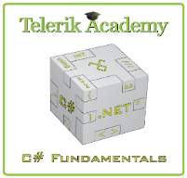

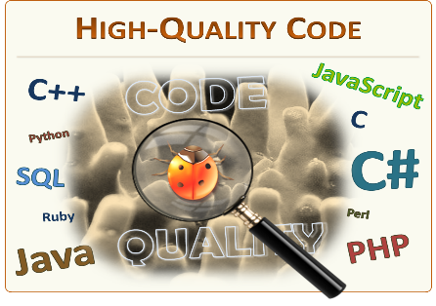
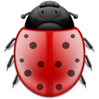
High-Quality Code: Teamwork defense
Presentation of project “King Survival” version 3
Team “Erbium”
Students at Telerik Academy

Slide 2
The team
Yoan Dinkov – student @ Telerik Academy
Vladislav Karamfilov – student @ Telerik Academy and volunteer assistant in summer academy
Nikolay Naidenov – student @ Telerik Academy and champion of “Photoshop” course

Slide 3
The beginning …
Smelly code
Used non-English variables, bad naming
Bad indentation, magic numbers
Strong cohesion, loose coupling
Everything was in 7 methods in 1 class
Can we test ?
Project was practically non-testable

Slide 4
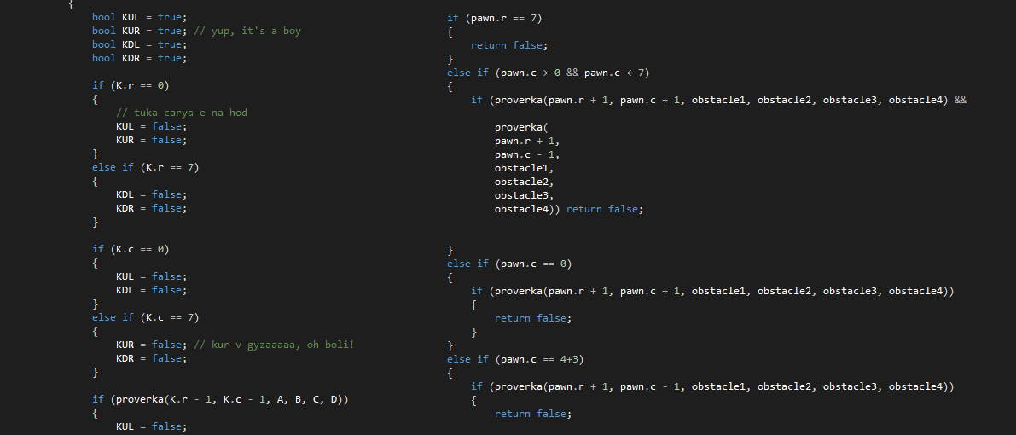
The beginning …

Slide 5



The real deal - refactoring
What have we done ?

Slide 6
What have we done ?
Changed all variable names
Divided the project to 3 main parts :
KingSurvival.Common – implementation of main logic
KingSurvival.UI – game presentation
KingSurvival.Tests – unit tests
Refactored all methods
Made code testable
Full information about every single method refactoring in “RefactoringDocumentation.docx”

Slide 7
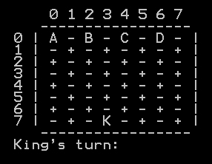
Game – live demo

Slide 8
How we did it ?
Made three meetings at Telerik after lessons
Near every day communication in social networks
Everyone made at least 5 commits in Git repository

Slide 9
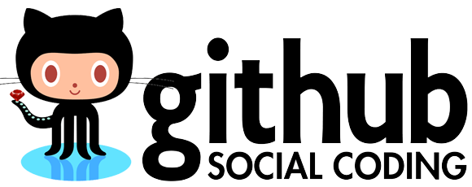
Git repository Demo

Slide 10
Unit testing information
Made over 12 tests
Code-coverage over 96%
Mocking-like tests
At least 8 in-game scenarios
Every possible king winning situation
Near all possibilities of king losing

Slide 11
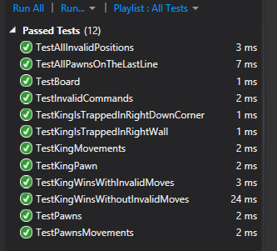
Unit testing demo

Slide 12
Teamwork Presentation
http://academy.telerik.com

